Slide 1




WEB PAGES DESIGN
Introduction to Web Programming
Lecturer: Dr. Atheer Akram AbdulRazzaq
Lecture 1.
Class 2.
Time: 10:30 - 12:30
Department: Businesses Information Technology (BIT)

Slide 2
Outline
Outline
Introduction
Creating a Website , Web Page Example
HTML Tags, Structural, Elements, title Element, meta Element,
HTML Attributes, body Elements: hr, p, br, div
Cascading Style Sheets Preview, History of HTML , Differences
Between Old HTML and HTML5
Summary

Slide 3
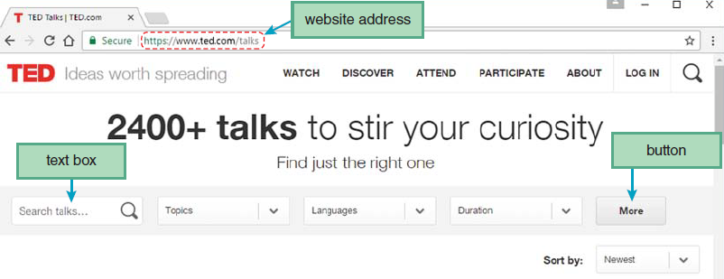
Outline
Introduction
A brief description of the Web, which is short for World Wide Web. Most people say “Web” instead of “World Wide Web,” and we’ll follow that convention. The Web is a collection of documents, called web pages, that are shared (for the most part) by computer users throughout the world. Different types of web pages do different things, but at a minimum, they all display content on computer screens. By “content,” we mean text, pictures, and user input mechanisms like text boxes and buttons, as shown in figure 1.
Note the web page’s text, pictures, text boxes, and buttons. Also note the web page’s address shown in the figure’s address bar. The web page address is the location where the web page resides on the Internet. Speaking of the Internet, what is it? It’s a collection of several billion computers connected throughout the world. Each web page is stored on one of those computers.
Figure1. A typical web page

Slide 4
Outline
Creating a Website
A website is a collection of related web pages that are normally stored on a single web server computer. A web server is a computer system that enables users to access web pages stored on the web server’s computer. The term “web server” can refer to the web page-accessing software that runs on the computer, or it can refer to the computer itself.
To create a website, you’ll need these things: (1) a text editor, (2) an upload/publishing tool, (3) a web hosting service, and (4) a browser.
Text editor: There are many different text editors, with varying degrees of functionality. Microsoft’s Notepad is free and provides no special web functionality. To use it, the web developer simply enters text, and the text appears as is. Although it’s possible to use a plain text editor such as Notepad, most web developers use a fancier type of text editor—a web authoring tool.
Upload/publishing tool: After you enter your web page text on your local computer with your favorite (integrated development environments) IDE, you’ll probably want to publish it. Publishing means that you upload your web page to a web server computer so other users can access it on the Web.

Slide 5
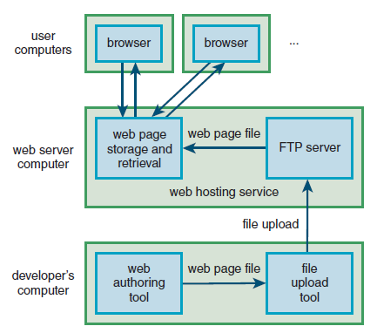
Outline
Creating a Website (continue…)
Web hosting service: For the uploaded files to be accessible as web pages on the Web, your web server computer needs to have a web hosting service in place. The web developer usually doesn’t have to worry about the web hosting service software. All web hosting services need to have a mechanism for receiving uploaded files from a file upload tool. Typically, that mechanism is an FTP (file transfer protocol) server, which is a program that runs on the web server computer, as shown in figure 2.
Browser: A browser is a piece of software that enables a user to retrieve and view a web page. According to http://gs.statcounter.com, the most popular browsers for computers are Google Chrome, Microsoft’s browsers (Microsoft Edge and Internet Explorer), and Mozilla2 Firefox, Opera, and Android’s default browser. Safari and Android are particularly popular with mobile devices.
Figure .2 Website file processing

Slide 6
Outline
Web Page Example
We’ll start with the website address. Formally, the website address value is known as a URL, which stands for Uniform Resource Locator. That name is not all that intuitive, so just remember that a URL is a website address, as shown in figure 3.
http://teach.park.edu/~jdean240/lecture/weather.html
The http refers to the hypertext transfer protocol, where a protocol is a set of rules and formats for exchanging messages between computers
After http comes a delimiter, ://, and then the name of the web server computer that stores the web page. The web server computer is teach.
Next comes the domain that describes how the web server can be found on the Internet. For this example, the domain is park.edu.
Next, there’s a sequence of directories and subdirectories (also called folders and subfolders) that indicate where the web page is stored on the web server computer. That’s called the path. For this example, the path is ~jdean240/lecture.
The ~ (tilde) at the left indicates that the directory is a home directory for a user’s account.
After the lecture subdirectory, there’s a / and then weather.html. The phrase weather.html is the web page’s filename.

Slide 7
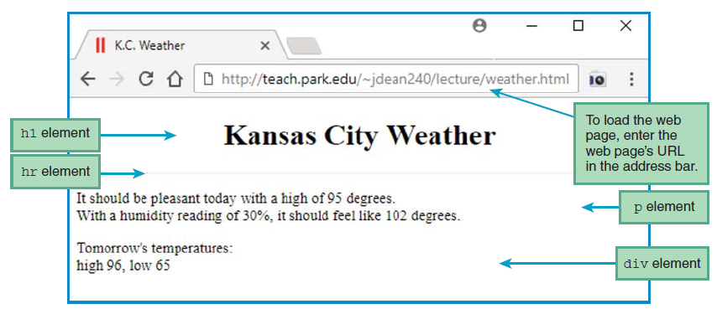
Outline
Web Page Example (continue…)
In Figure.3, all the things you see below the address bar are web page elements—h1, hr, p, and div.
The h1 element is used to implement a web page heading, with the “h” in h1 standing for “heading.”
The hr element is used to implement a horizontal line, with the “h” and “r” standing for “horizontal” and “rule,” respectively.
The p element is used to implement a paragraph.
A div element is used to group words together as part of a division within a web page.
Figure.3 City Weather web page

Slide 8
Outline
HTML Tags
The use of tags is the key characteristic of a markup language. Why is it called “markup”? A markup language “marks up” a document by surrounding parts of its content with tags.
Web pages are implemented with HTML, which stands for Hypertext Markup Language.
Most, but not all, HTML tags come in pairs with a start tag and an end tag. For example, the following code uses an <h1> start tag and an </h1> end tag:
<h1>Today's Weather</h1>
Besides h1, there are other heading elements—h2 through h6. The element h1 generates the largest heading, and h6 generates the smallest.
Note: There are two types of elements—container elements and void elements. A container element (usually called simply a “container”) has a start tag and an end tag, and it contains content between its two tags. For example, the h1 element is a container. On the other hand, a void element has just one tag, and its content is stored within the tag.

Slide 9
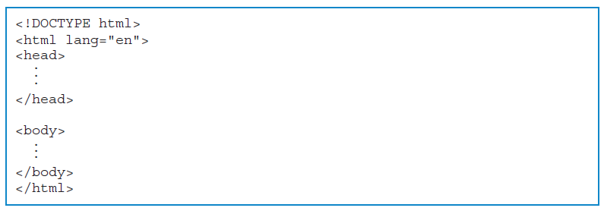
Outline
Structural Elements
The basic framework for all web pages-doctype, html, head, and body.
The doctype construct is considered to be an instruction, not an element, and it goes at the top of every web page.
The html, head, and body elements form the basic structure of a web page, so we’ll refer to those elements as structural elements.
The first construct, <!DOCTYPE html>, tells the browser what type of document the web page is. Its html value (in <!DOCTYPE html>) indicates that the document is an HTML document, and more specifically that the document uses the HTML5 standard for its syntax.
After the doctype instruction comes the html element. It’s a container, and it contains/ surrounds the rest of the web page.
Its start tag includes lang="en", which tells the browser that the web page is written in English.
The head and body elements are also containers. The head element surrounds elements that provide information associated with the web page as a whole.
FIGURE 4. Skeleton code using just doctype and the structural elements

Slide 10
Outline
Structural Elements (continue…)
Example 1. Source code for Kansas City Weather web page (in figure3)
<!DOCTYPE html>
<html lang="en">
<head>
<meta charset="utf-8">
<meta name="author" content=“AAA">
<meta name="description" content="Kansas City weather conditions">
<title>K.C. Weather</title>
<style>
h1 {text-align: center;}
hr {width: 75%;}
</style>
</head>
<body>
<h1>Kansas City Weather</h1>
<hr>
<p>
It should be pleasant today with a high of 95 degrees.<br>
With a humidity reading of 30%, it should feel like 102 degrees.
</p>
<div>
Tomorrow's temperatures:<br>
high 96, low 65
</div>
</body>
</html>

Slide 11
Outline
title Element
The head element contains two types of elements-meta and title. In your web pages, you should position them in the order shown in Figure 5. meta and then title.
The title element’s contained data specifies the label that appears in the browser window’s title bar.
The official HTML standard requires that every head container contains a title element.
Besides providing a label for your browser window’s title bar, what’s the purpose of the title element?
1. It provides documentation for someone trying to maintain your web page.
2. It helps web search engines find your web page, as shown in figure 5.
<head>
<meta charset="utf-8">
<meta name="author" content=“AAA">
<meta name="description" content="Kansas City weather conditions">
<title>K.C. Weather</title>
</head>
Figure 5. head container for Kansas City Weather web page

Slide 12
Outline
meta Element
The meta elements provide information about the web page.
The meta element is a void element (not a container), so it does not have an end tag.
Many web programmers end their void elements with a space and a slash. For example:
<meta charset="utf-8" />
HTML Attributes
Container elements provide information between their start and end tags. Void elements (including the meta element) have no end tags, so they can’t provide information that way. Instead, they provide information using attributes.
In the following example, charset is an attribute for a meta element:
<meta charset="utf-8">
Most attributes have a value assigned to them. In this example, charset is assigned the value "utf-8".
You should always surround attribute values with quotes, thus forming a string. A string is a group of zero or more characters surrounded by a pair of double quotes (“) or a pair of single quotes (‘), with double quotes preferred.

Slide 13
Outline
HTML Attributes (continue…)
HTML Attributes (continue…)
Attributes are more common with void elements, but they can be used with container elements as well. For example of a container element that uses an attribute:
<html lang="fr">
•
•
•
</html>
meta charset Element: There are different encoding schemes, and in order for the receiving end of a transmission to understand the transmitted binary data, the receiver has to know the encoding scheme used by the sender. For web page transmissions, the meta charset element specifies the encoding scheme.
Normally, you should use a charset value of “utf-8” because all modern browsers understand that value.

Slide 14
Outline
HTML Attributes (continue…)
HTML Attributes (continue…)
meta name Element: Common values for the meta name attribute are author, description, and keywords. Here’s an example with an author value for a name attribute:
<meta name="author" content="Ahmed Ali">
The name and content attributes go together. The name attribute’s value specifies the type of thing that the content attribute’s value specifies.
In the following examples, the name attribute uses the values “description” and “keywords”:
<meta name="description" content="Kansas City weather conditions"
<meta name="keywords" content="KC, weather, forecast"
The meta description element and also the meta keywords element help web search engines find your web page.
In addition, the meta description element helps the person reading the code learn the purpose of the web page.

Slide 15
Outline
body Elements: hr, p, br, div
The hr element is used to render a horizontal line. The “h” in hr stands for horizontal. The “r” in hr stands for rule, presumably because a rule is another name for a ruler, which can be used to make a straight line.
The hr element is a void element, so it uses just one tag, <hr>.
The p element is a container for a group of words that form a paragraph. Normally, browsers will render a p element’s enclosed text with a blank line above the text and a blank line below it.
A div element is also a container for a group of words, but it’s more generic, so the words don’t have to form sentences in a paragraph. div stands for division because a division can refer to a part of something that has been divided, and a div element is indeed a part of a web page. The div element causes its enclosed text to have single line breaks above and below it.
The br element, which is used to render a new line, as shown in figure 6.
For example:
It should be pleasant today with a high of 95 degrees.<br>

Slide 16
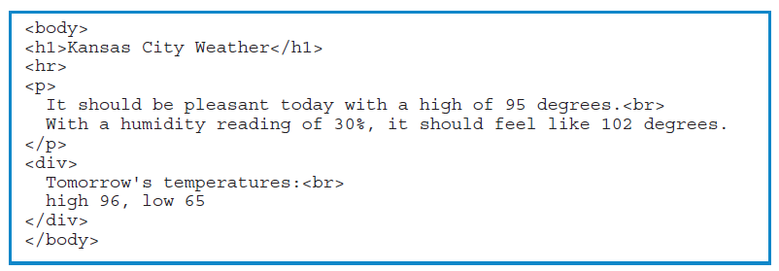
Outline
body Elements: hr, p, br, div( continue…)
Cascading Style Sheets Preview
CSS allows you to add formatting to your web pages. The formatting rules go inside a style container.
In the skeleton code for the weather web page in figure 7. , note the style container within the head container. Within the style container, note the two lines that begin with h1 and hr.
Figure 6. body container for Kansas City Weather web page

Slide 17
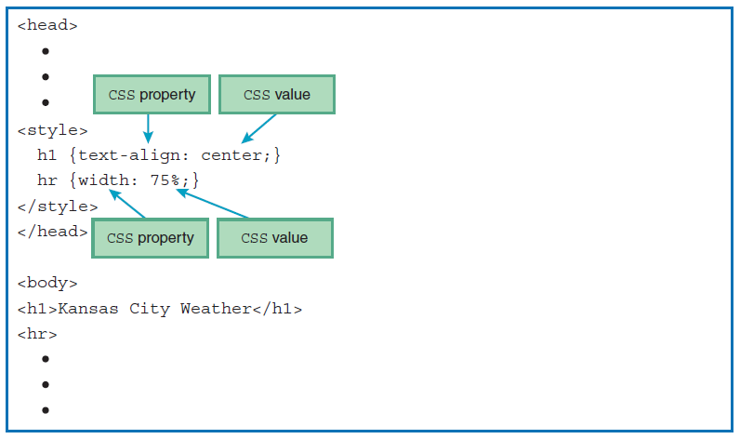
Cascading Style Sheets Preview ( continue…)
Outline
Cascading Style Sheets Preview (continue…)
Those lines are the rules that apply to the h1 and hr elements in the body container. Each rule has a CSS property and a CSS value, separated by a colon.
The first rule, for h1, uses a text-align property with a value of center. Other text-align values are left and right. The second rule, for hr, uses a width property with a value of 75%.
figure 7. style container for Kansas City Weather web page

Slide 18
History of HTML
Outline
In 1989, Tim Berners-Lee came up with the idea of adding “hypertext links” to research papers, so when one paper referred to another, the reader could click the link and quickly go to the other paper.
From 1989–1991, Berners-Lee was quite prolific: (1) He designed HTML, with hypertext links as the key feature, (2) he designed the concepts behind the World Wide Web, including the HTTP protocol, and (3) he created a prototype browser for surfing the Internet with HTML web pages.
In 1993, Tim Berners-Lee and Dan Connolly submitted the first formal proposal for HTML to the Internet Engineering Task Force (IETF).
In 1994, Berners-Lee founded the World Wide Web Consortium (W3C) at the Massachusetts Institute of Technology.
By 1997, the HTML standard evolved to HTML4, with HTML4’s last revision appearing in 2000 as HTML 4.01.
The WHATWG spent five years, from 2004 through 2009, creating a Web Apps 1.0 standard.
In 2009, after making very little progress on XHTML 2.0, the W3C abandoned their XHTML 2.0 efforts and formed a collaborative relationship with WHATWG, using Web Apps 1.0 standard as basis for their current HTML5 standard.
In 2011, the W3C came out with a super-cool HTML5 logo.
The first version was simply called “HTML5.” The next version was called “HTML 5.1,” with a space before 5.1. As of 2017, HTML 5.1 was the W3C’s official “recommendation,” and HTML 5.2 was a “working draft,” with the expectation that it would soon become a recommendation.

Slide 19
Differences Between Old HTML and HTML5
Outline
The following differences show how HTML5 has loosened up some of its syntax rules as compared to XHTML 1.0:
With HTML5, there’s no longer a requirement to have a quoted value for every attribute.
With HTML5, there’s no longer a requirement to have a / for all void elements. For example, the XHTML specification requires writing the br void element with a slash, <br/>. The HTML5 specification says you can include or omit the slash.
With HTML5, there’s no longer a requirement to have an end tag for every container. The XHTML specification requires including a </p> end tag for every p container element.
The HTML5 standard includes quite a few new constructs. The following list shows just some of them:
Structural organization elements—Two examples are the header and footer elements.
Audio and video-The audio and video elements allow users to play music and video files directly from their browsers without need of a plug-in.

Slide 20
Differences Between Old HTML and HTML5 (continue…)
Outline
Canvas—The canvas element provides a drawing area and a set of commands that a web programmer can use to draw two-dimensional shapes and animate them.
Drag and drop functionality—The drag and drop constructs provide the ability to drag elements within a web page.
Web storage functionality—The web storage constructs provide the ability to permanently store data on the browser’s computer.
Geolocation functionality—The geolocation constructs provide the ability to locate the browser’s computer.

Slide 21
Outline
Summary
This lecture showed a brief description of the Web, which is short for World Wide Web.
Also from this lecture we learned what is the web server, which is a computer system that enables users to access web pages stored on the web server’s computer.
The website address value is known as a URL, which is stands for Uniform Resource Locator.
In this lecture briefly explained the two types of elements (container elements and void elements). A container element has a start tag and an end tag, and it contains content between its two tags, while the a void element has just one tag, and its content is stored within the tag.
Also we highlighted on the structural elements and started with DOCTYPE construct that considered to be an instruction, not an element, while the html, head, and body elements form the basic structure of a web page.
This lecture clarified what is the purpose of the title element, which provides documentation for someone trying to maintain your web page and helps web search engines find your web page.
For the meta element, we learned the purpose of the name attribute and the content attribute, which are the name attribute specifies the meta element’s type, and the content attribute specifies the meta element’s value.
In this lecture explained briefly the Cascading Style Sheets, the history of HTML and differences between Old HTML and HTML5.

Slide 22


THANK YOU

